Slide 1
Analytics on Mutual Funds and ETFs

Slide 2
What is Mutual Funds and ETFs?
Exchanges(PCX, NAS, NGM, BTS, PNK, etc)
Fund Category
Fund Family
Return
Sharpe Ratio and Treynor Ratio
Investment Type(Growth, Value, Blend)

Slide 3
Potential Clients
Investment Banks
Fund Managers
Investment Management Firms

Slide 4
End-to-End Analytical Solutions
Data Engineering
Data Analytics using SQL
BI Dashboards
Data Science

Slide 5
Data Engineering Solution
Step 1
Step 2
Step 3
Step 4
Step 5
Data Preparation Phase
Data Landing Phase
Data Transformation Phase
Data Modelling(using dimension and fact tables)
Data Staging Phase

Slide 6
stg_etfs_exchange_code_pcx
ldg_etfs
stg_etfs
stg_etfs_exchange_code_bts
stg_etfs_exchange_code_ngm
stg_etfs_investment_type_blend
stg_etfs_investment_type_growth
stg_etfs_exchange_code_pnk
stg_etfs_investment_type_value
stg_etfs_prices
df_etfs_price

Slide 7
ldg_mutual_funds
stg_mutual_funds
stg_mutual_funds_fund_family_bny_mellon
stg_mutual_funds_fund_family_credit_suisse
stg_mutualfunds_investment_type_blend
stg_mutual_funds_fund_family_wells_fargo_bonds
stg_mutualfunds_investment_type_growth
stg_mutual_funds_fund_family_capital
stg_mutualfunds_investment_type_value
stg_mutualfunds_prices
df_mutualfund_prices

Slide 8
Analytics on ETFs

Slide 9
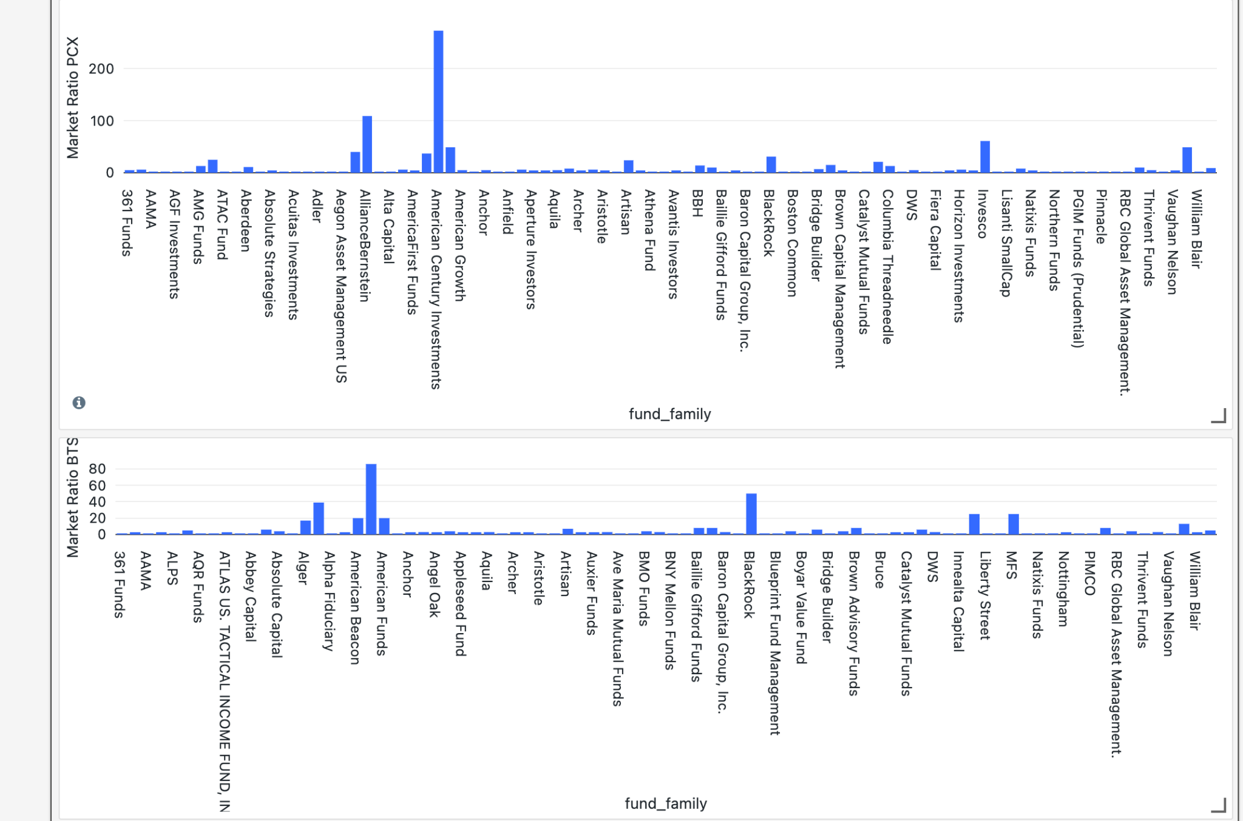

Slide 10
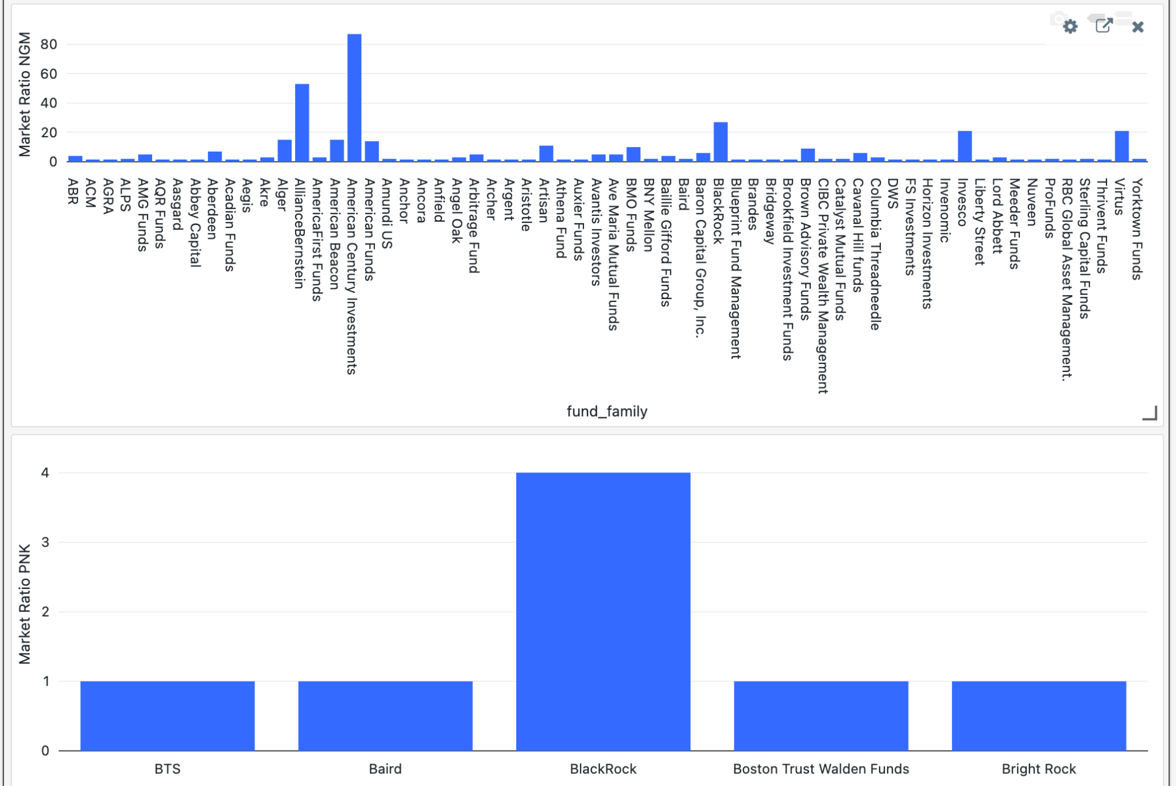

Slide 11
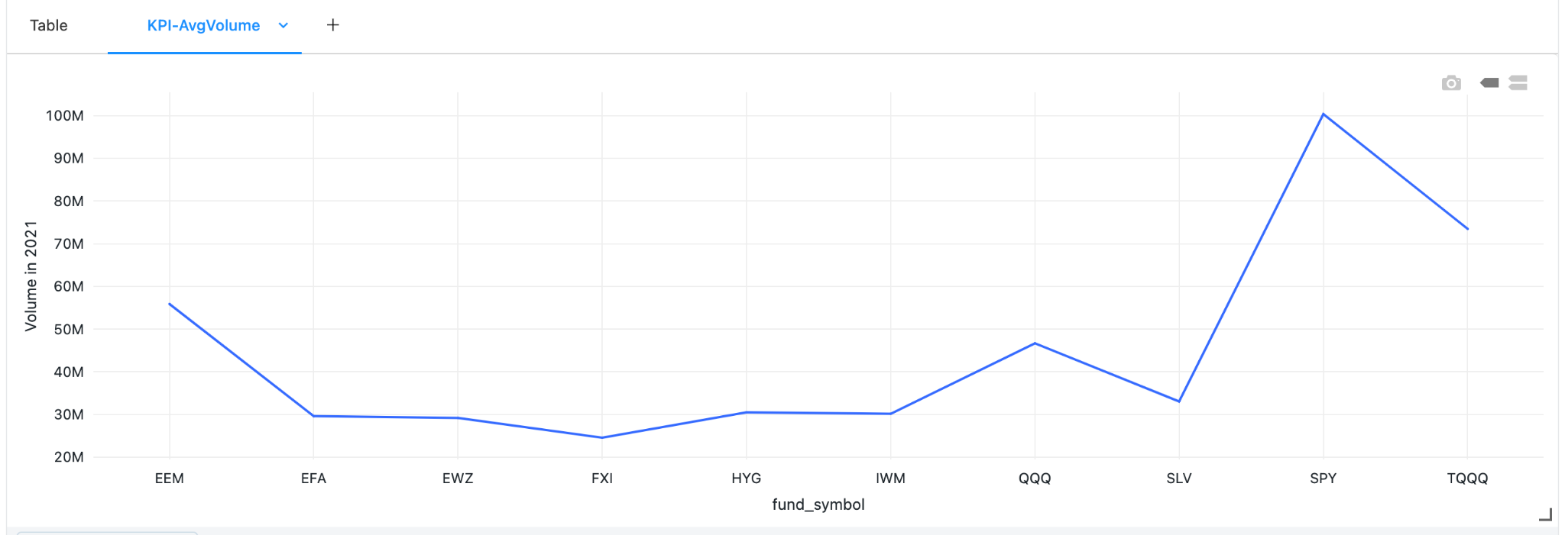

Slide 12
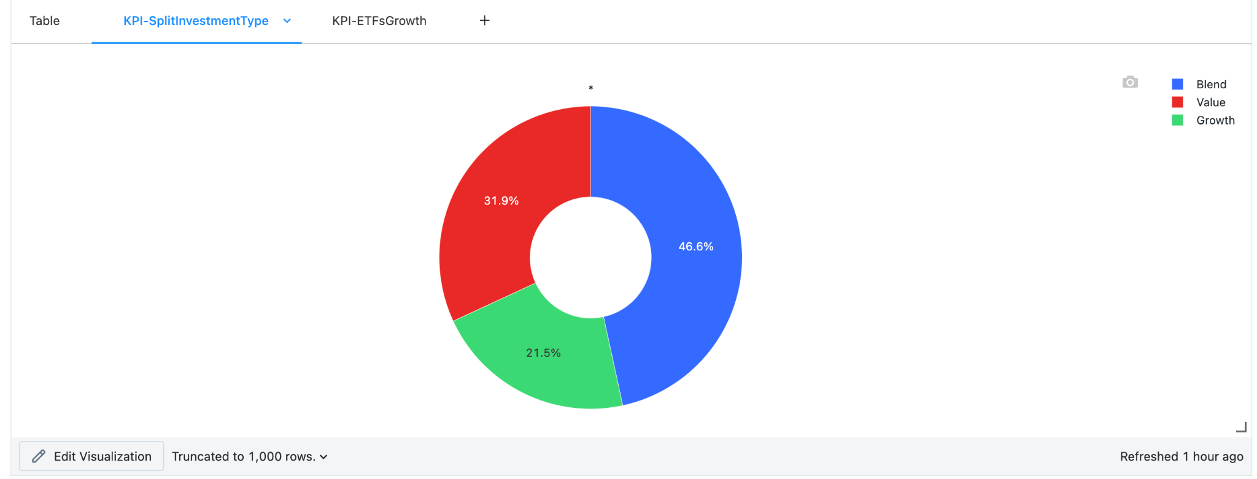
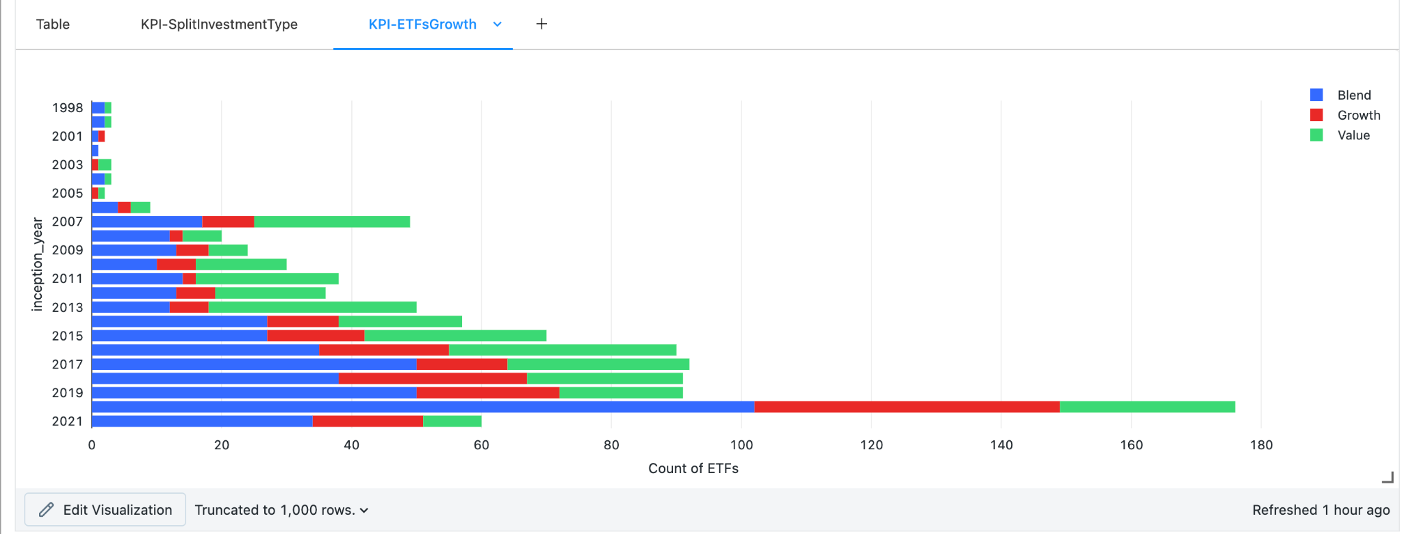

Slide 13
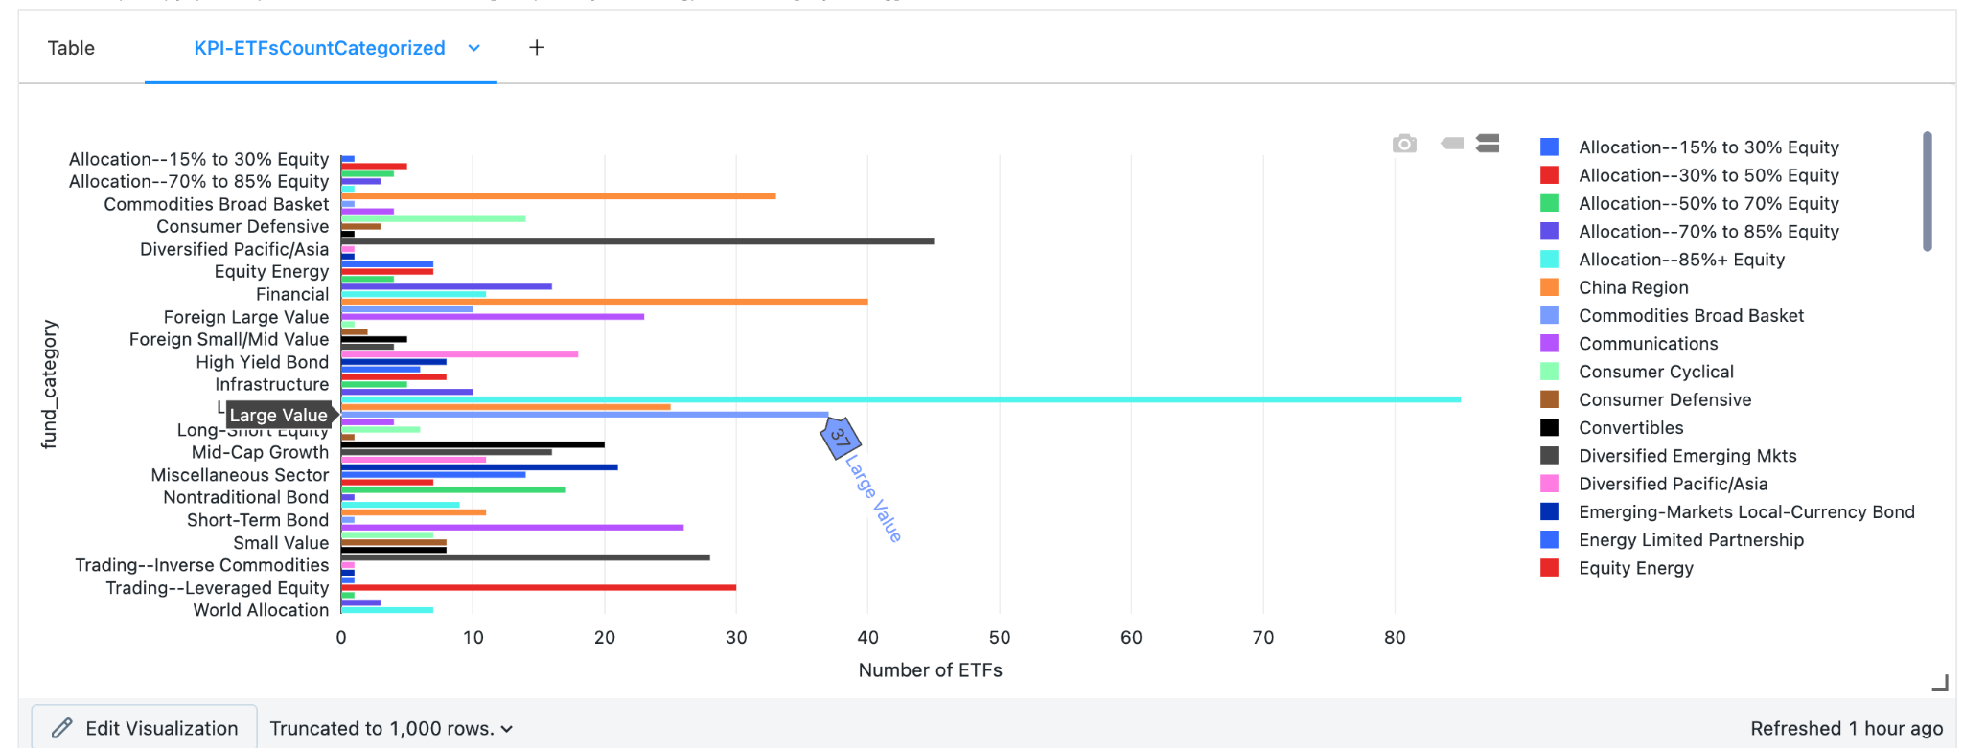

Slide 14
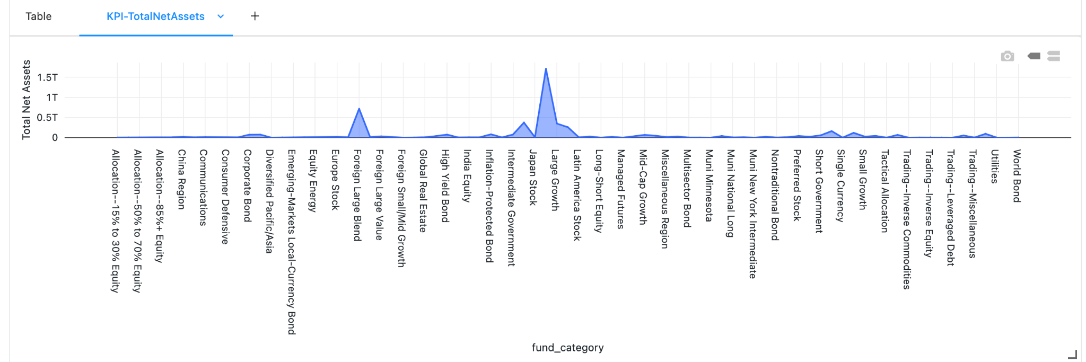

Slide 15
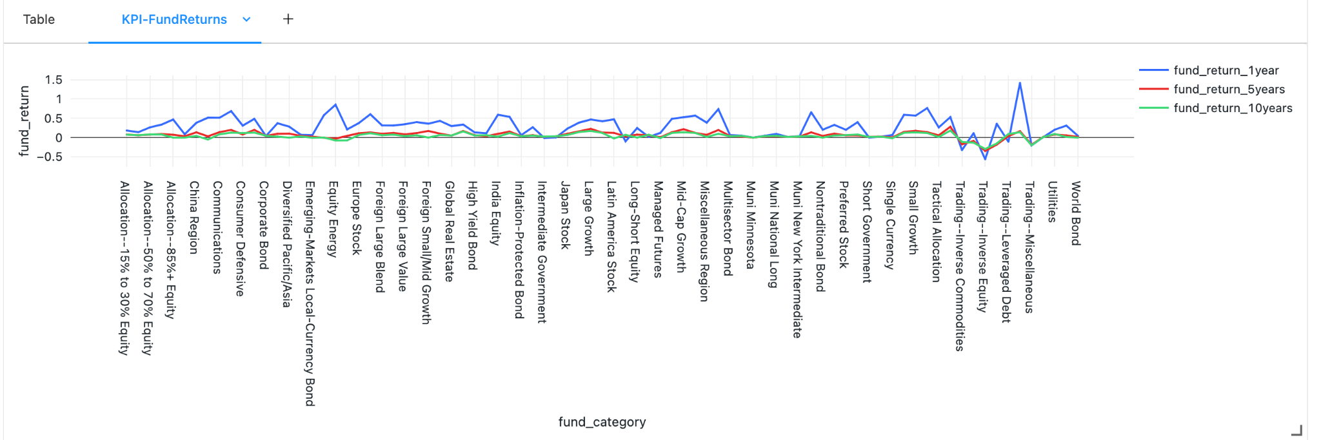

Slide 16
Analytics on Mutual Funds

Slide 17
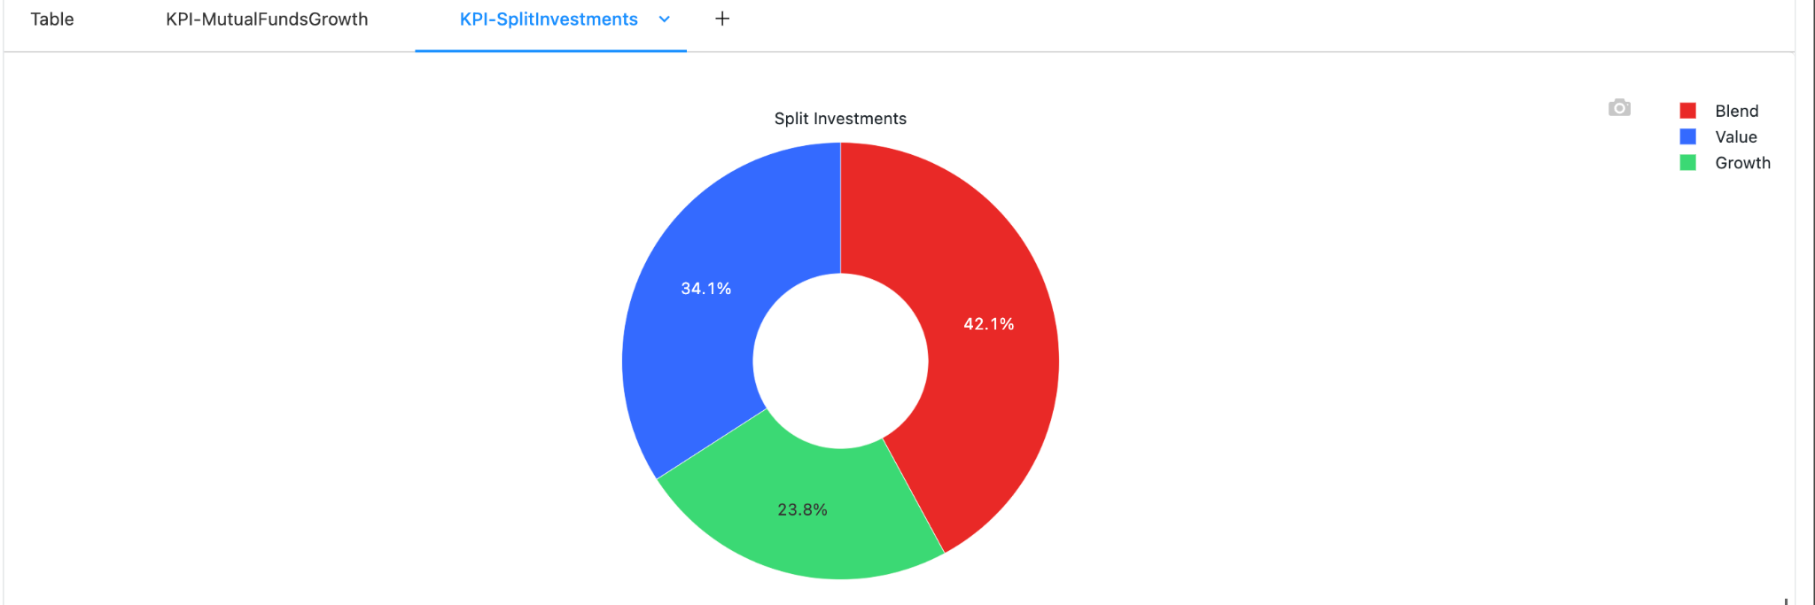
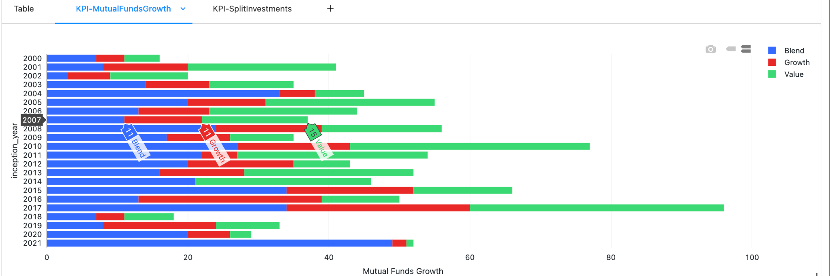

Slide 18
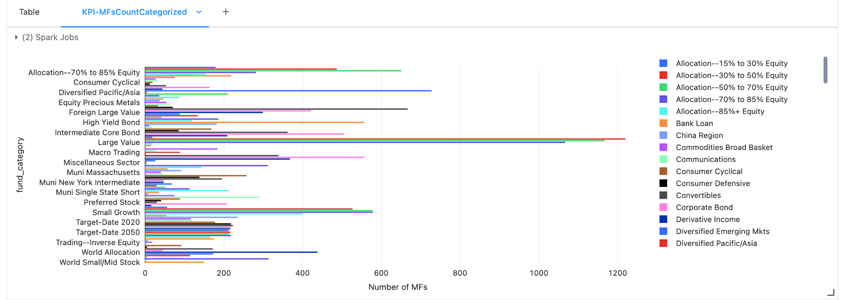

Slide 19
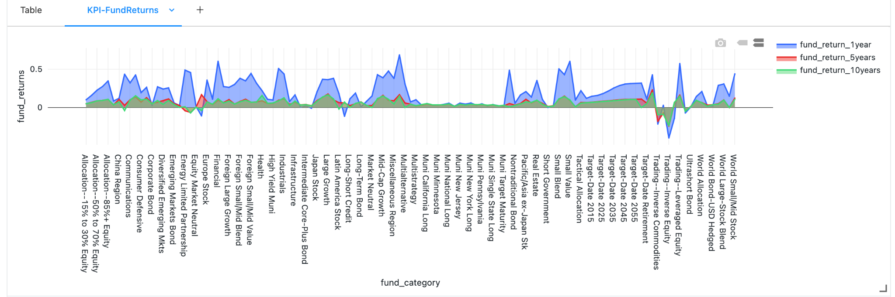

Slide 20
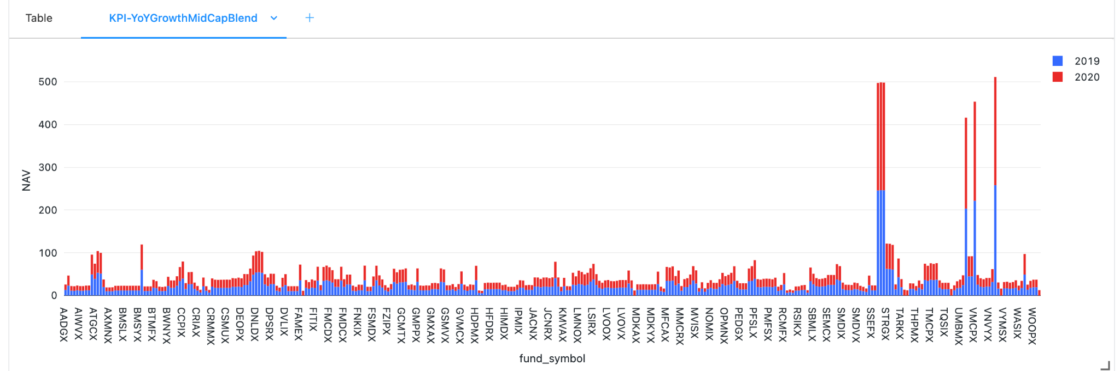
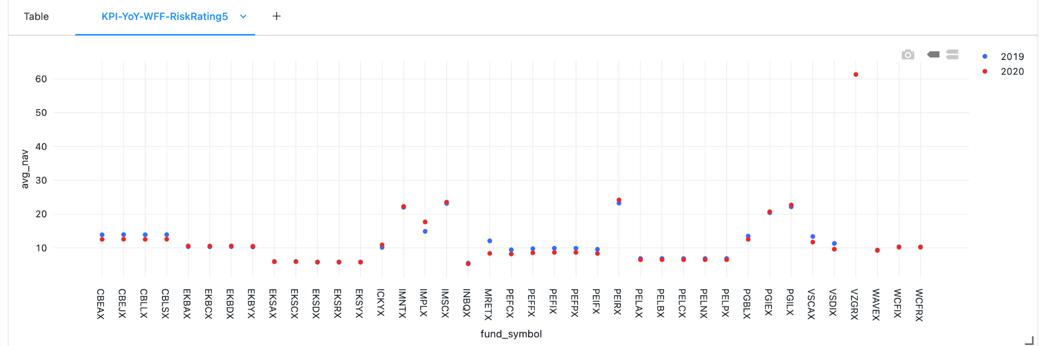

Slide 21
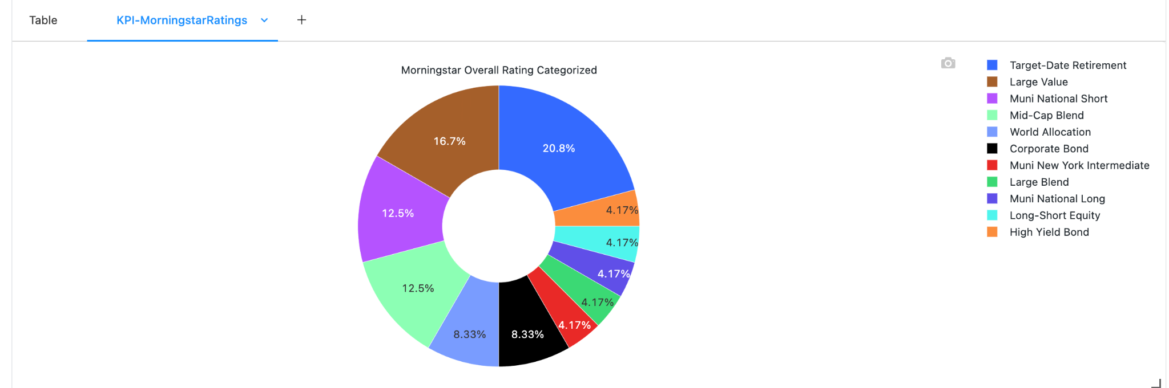

Slide 22
Data Science Models
Decision Tree Classifier to predict the stock prices change
In order to estimate the daily stock price, we proposed a novel approach based on a mix of Decision Tree Models to identify comparable historical trends for each stock item.
Links -
https://databricks-prod-cloudfront.cloud.databricks.com/public/4027ec902e239c93eaaa8714f173bcfc/2473808915535970/3284784867162662/3114305975200740/latest.html
https://databricks-prod-cloudfront.cloud.databricks.com/public/4027ec902e239c93eaaa8714f173bcfc/2473808915535970/3284784867162662/3114305975200740/latest.html
https://databricks-prod-cloudfront.cloud.databricks.com/public/4027ec902e239c93eaaa8714f173bcfc/2473808915535970/3284784867162662/3114305975200740/latest.html

Slide 23
Future Work
Thank You!
Streaming Data
Transforming Generic Framework as per the client needs
Scale up the systems
Working on Incremental loads

